Slide 1
chapter 4
Local Area Networks - Connectivity

Slide 2
CHAPTER OBJECTIVES
4-<number>
Describe the purpose of a repeater and indicate where repeaters are used.
Discuss different hub technologies and where hubs are used.
Discuss bridge technology and identify where bridges are used.
Discuss switch technologies.
Compare the differences between routing and switching.
List the functions of a gateway, and identify the reasons that gateways are implemented.

Slide 3
CHAPTER OBJECTIVES (cont’d)
4-<number>
Identify the three layers of network
Describe the Internet Protocol and provide examples of different IP address classes.
Identify different methods of assigning IP addresses and the business impact of DHCP.
List and describe other LAN communications protocols and their importance.
Describe the network management protocol, SNMP.

Slide 4
LAN DEVICES
4-<number>
These are the hardware components that provide the interfaces among servers, workstations, and media types in a LAN.
LAN devices provide a variety of functions.
Repeaters, hubs, bridges, switches, routers, and gateways are common LAN devices.

Slide 5
LAN DEVICES
4-<number>
Repeater – extends the distance over which a signal can be transmitted.
  It’s an OSI layer 1 device.
  A repeater receives a signal from a media segment, cleans the signal, amplifies it, and then sends the signal onto the next media segment.
  Repeaters are commonly built into LAN devices such as hubs or switches.

Slide 6
LAN DEVICES
4-<number>
Hubs – are LAN devices to which servers, workstations, printers, and other computing devices can be connected.
  Hubs are OSI layer 1 devices.
  Hubs do not interpret data – that is, they’re unaware of source and destination addresses.
  All packets flowing through a hub are broadcast to all other devices that are connected to the hub.

Slide 7
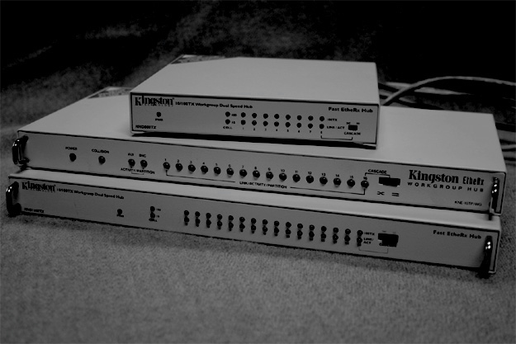
Simple LAN Hubs
4-<number>

Slide 8
LAN DEVICES
4-<number>
Bridges
  Are LAN devices that connect two or more LAN segments while simultaneously filtering network data transmissions between the segments.
  Bridges are sometimes referred to as “forward if not local” LAN devices.
  A bridge can improve overall LAN performance.

Slide 9
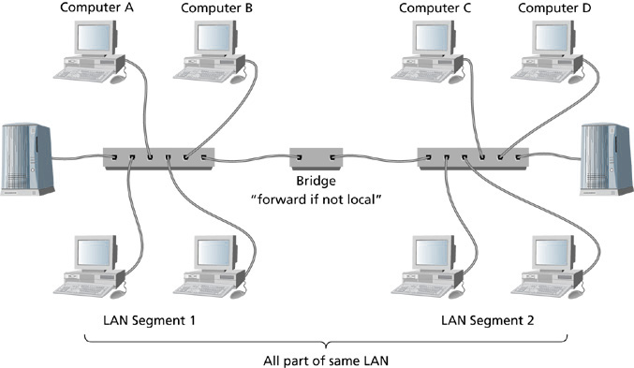
LAN Bridge Connecting Two LAN Segments
4-<number>

Slide 10
LAN DEVICES
4-<number>
Bridges (cont’d)
  Have a built-in algorithm that learns the MAC (Media Access Control) address of each network card in each computing device on each LAN segment that is connected to the bridge.
  MAC addresses are stored in a MAC address table.
  The MAC address table is used in filtering data transmissions between LAN segments.

Slide 11
LAN DEVICES
4-<number>
Switches
  Are very similar to bridges.
  Switch ports can be directly connected to individual PCs, servers, hubs, bridges, other switches, and to routers whereas:
    Bridges were typically connected to hubs or other bridges.
  Switches use special hardware components that can read multiple ports simultaneously and establish multiple and simultaneous forwarding paths whereas:
    Bridges generally had a single central processor that limited frame processing and forwarding to one frame at a time.

Slide 12
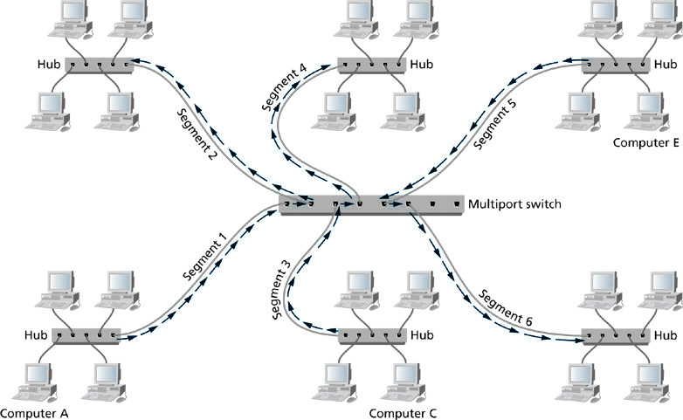
Data Propagation on a Multiport Switch
4-<number>

Slide 13
LAN DEVICES
4-<number>
Store and Forward Switches
  Are designed to perform error checking on each frame after the entire frame has been received into the switch.
  If the frame is error free, the switch forwards the frame to the appropriate port.
  Bad frames are not forwarded which makes this switch type highly reliable.
  They are slower than other switch types because they hold onto each frame until it is completely received in to check for errors.

Slide 14
LAN DEVICES
4-<number>
Cut Through Switches
  Do not perform error checking on frames.
  Are faster than store and forward switches.
  Read only the address information for each frame as frames enter the switch.

Slide 15
LAN DEVICES
4-<number>
Higher Layer Switches
  Traditional switches operate at OSI layer 2.
  Newer switches can incorporate functionality for OSI layer 3 and OSI layer 4.
  Layer 3 switches add routing capability.
  Layer 4 switches add TCP port-level services.

Slide 16
LAN DEVICES
4-<number>
Routers
  Operate at OSI layer 3.
  Allow packets to flow between networks.
  Connect two or more networks, separate broadcast domains, and direct packets to their destinations based on IP addresses and across the best possible route.
  Establish a path over which computers on one network can communicate with computers on another network.

Slide 17
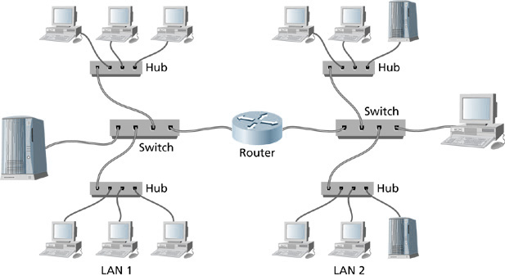
Two Networks Connected by a Router
4-<number>

Slide 18
LAN DEVICES
4-<number>
Routers (cont’d)
  Improve network security by filtering broadcasts.
  Can be installed at the edge or border of a LAN to connect a LAN to distant networks.
  Each router maintains a routing table that stores addresses of other networks and best paths and path costs to other networks.

Slide 19
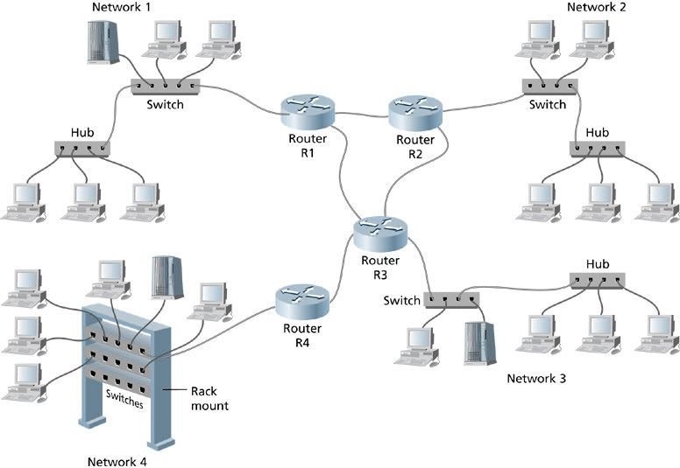
Networks Interconnected by Routers
4-<number>

Slide 20
LAN DEVICES
4-<number>
Creating Routing Paths
  Static Routing – a network administrator defines the paths to other networks, creates an entry for each path, assigns metrics to those paths, and manually enters this information into the routing table.
  Static routing is effective when routing metrics are not expected to change over time.

Slide 21
LAN DEVICES
4-<number>
Creating Routing Paths (cont’d)
  Dynamic routing – provides a mechanism for routers to automatically accommodate new routes and changing network conditions using sophisticated software known as a dynamic routing algorithm.
  The routing algorithm is part of the router’s operating system, and when a change is detected along any of the paths between the source and destination network, the routing algorithm recalculates optimal paths and updates the routing table.
  The routing algorithm also exchanges updated information with other routers.

Slide 22
LAN DEVICES
4-<number>
Gateways
  A gateway is hardware or software or a combination of both that provides protocol translation or connectivity between disparate systems.
  Operate above OSI layer 3.
  Example use includes connecting a LAN to a mainframe computer, connecting a LAN e-mail system to external e-mail providers, and connecting a non IP network to the Internet.

Slide 23
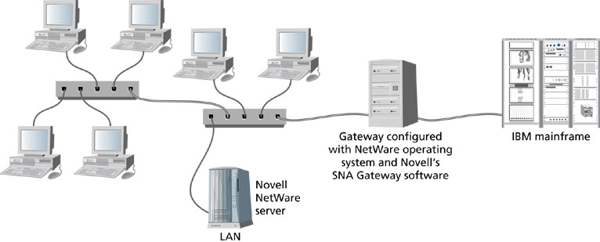
Connecting Client Workstations to a Mainframe through Novell’s SNA Gateway Software
4-<number>

Slide 24
LAN BACKBONES
4-<number>
Network Backbones
  Are the combination of hardware, media, protocols, and architecture that form the high-speed communications links between two networks.

Slide 25
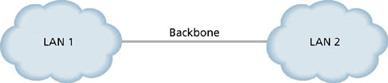
Simple Backbone
4-<number>

Slide 26
LAN BACKBONES –
BACKBONE DESIGN
4-<number>
Backbone Fault Tolerance and Load Balancing
  Fault tolerance provides the ability to continue transmitting data across the backbone in the event that a backbone device or data path fails.
  Load balancing provides the ability to transmit data that’s going to the same destination across multiple paths simultaneously.
  Requires the implementation of duplicate distribution layer switches, duplicate core layer switches, and redundant cabling to establish the extra data paths.

Slide 27
BACKBONE DATA TRANSMISSION ARCHITECTURES
4-<number>
Any network backbone should incorporate a high-speed data transmission architecture.
Examples include FDDI, ATM, Gigabit Ethernet, and 10 Gig Ethernet.

Slide 28
EXPANDED NETWORK BACKBONES
4-<number>
Expanded network backbones exist whenever an organization needs to interconnect multiple distribution facilities.
The most common architecture applied is Gigabit Ethernet or 10 Gigabit Ethernet.
Multiple floors and multiple buildings can be linked via expanded backbones.

Slide 29
LAN PROTOCOLS
4-<number>
Protocols are the rules that specify how services and devices exchange information.
Protocols define the ways in which data can be packaged, how data can access a network medium, how data can be transported, how data is reassembled at the destination, and so on.

Slide 30
LAN PROTOCOLS
4-<number>
Communications Protocols
  Allow us to send and receive information from remote data sources.
  Are the building blocks for information exchange.
  The Internet Protocol is an example of a communications protocol.

Slide 31
LAN PROTOCOLS
4-<number>
The Internet Protocol
  Provides an addressing scheme for networks and nodes to uniquely identify individual networks and the devices connected to those networks.
  Allows network devices to be located anywhere in the world so that source and destination devices can exchange information.

Slide 32
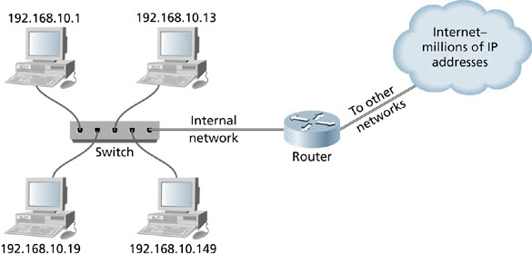
Internet Protocol and Data Communication
4-<number>

Slide 33
LAN PROTOCOLS
4-<number>
IP Addressing
  Most common implementation of IP addressing today is IPv4.
  With IPv4, each IP address is comprised of a 32-bit binary address that is divided into four 8-bit octets.

Slide 34
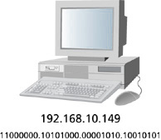
IP Address for a Network Device Using IP’s 32-bit Binary Addressing
4-<number>

Slide 35
LAN PROTOCOLS
4-<number>
IP Addressing (cont’d)
  IP addresses can be represented in numeric dotted decimal form or in binary form.
  Dotted decimal form can be converted to binary using powers of 2 to achieve the binary equivalent.

Slide 36
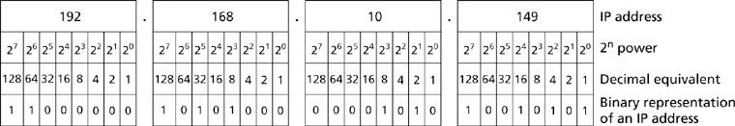
Binary to Dotted Decimal Conversion Grid
4-<number>

Slide 37
LAN PROTOCOLS
4-<number>
IP Addressing (cont’d)
  IP Addressing also uses subnet masking to separate the network portion of the IP address from the node portion.
  The subnet mask is also a 32-bit combination of binary digits.
  If the subnet mask contains a binary 1 digit, then the corresponding binary digit in the IP address is part of the network address.
  If the subnet mask contains a binary zero digit, then the corresponding binary digit in the IP address is part of the node address.

Slide 38
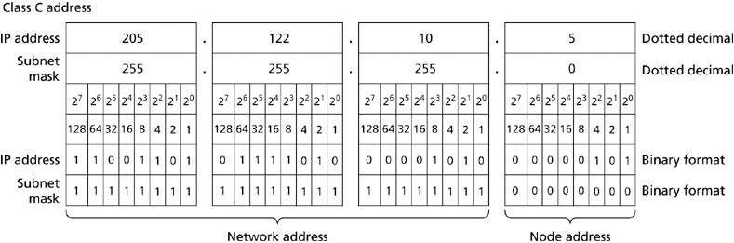
Separating an IP Address into its Network and Node Portions
4-<number>

Slide 39
LAN PROTOCOLS
4-<number>
The Internet Protocol has 5 different address classes:
  Class A – the first binary digit in the first octet is always a binary zero. Addresses range from 1 to 126 in the first octet. Default subnet mask is 255.0.0.0.
  Class B – the first two binary digits in the first octet begin with the binary digits, 10. Addresses range from 128 to 191 in the first octet. Default subnet mask is 255.255.0.0.
  Class C – the first three binary digits in the first octet begin with the binary digits, 110. Addresses range from 192 to 223 in the first octet. Default subnet mask is 255.255.255.0.

Slide 40
LAN PROTOCOLS
4-<number>
Address classes (cont’d)
  Class D – is used for IP multicasts. The first four binary digits of the first octet begin with 1110. Addresses range from 224 to 239 in the first octet.
  Class E – is reserved and used in broadcast transmissions within a defined network. The first octet ranges from 240 to 255.

Slide 41
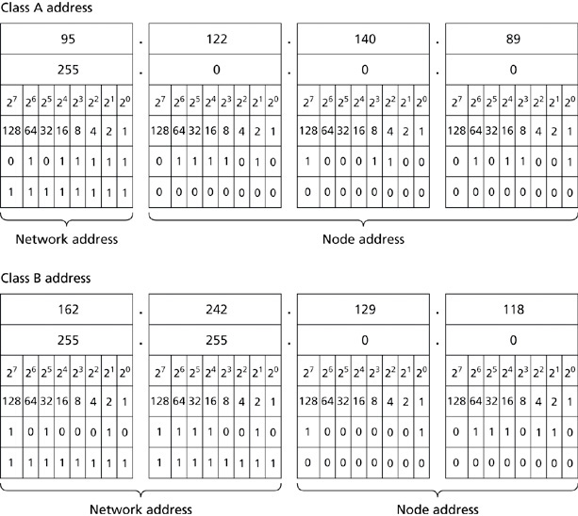
Network and Node Portions of IP Addresses
4-<number>

Slide 42
LAN PROTOCOLS
4-<number>
Assigning IP Addresses
  Manual IP Address Assignment – each LAN device is assigned a static IP address. Requires that each device be manually configured with an IP address.
  Automatic IP Address Assignment – is achieved with DHCP. Configuration of a range of addresses takes place on a DHCP server, and manual assignment of IP addresses is reduced to devices that require such a manual assignment.

Slide 43
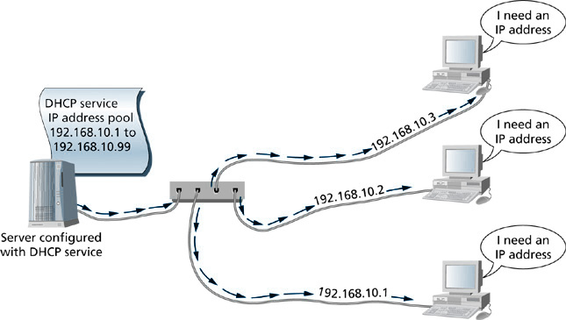
DHCP-Delivered IP Addresses
4-<number>

Slide 44
LAN PROTOCOLS
4-<number>
Network Management
  SNMP is a standardized application layer protocol that is used to communicate with, monitor, and control network devices such as hubs, switches, routers, and even NICs for the purpose of collecting network traffic and performance statistics.
  SNMP works in conjunction with SNMP agent software, SNMP manager software, and MIBs (Management Information Base).

